Slide 1

OptiPrice Prognosticator: E-commerce Optimal Pricing

Slide 2

INTRODUCTION & PROJECT REVIEW:
Data-Driven Price Prediction
Multiple Machine Learning Models
Structured Data Utilization
Demand and Market Analysis
Interactive Streamlit Dashboard

Slide 3
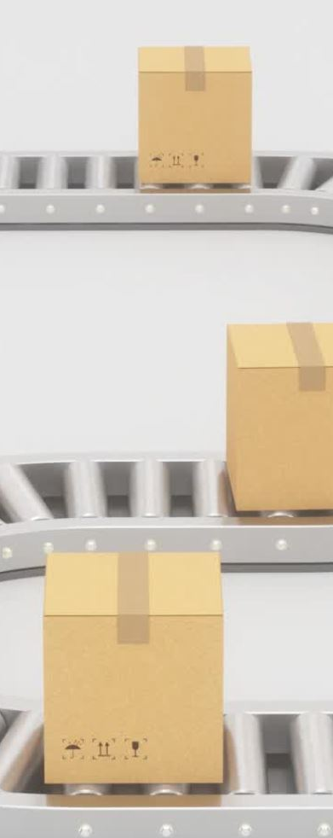
KEY FEATURES & FUNCTIONALITIES:
Demand and Performance Analysis
Sales Demand Analysis
Pricing Trend Insights
Market Need Alignment
Stock Availability Monitoring
Performance Metric Review
Price Prediction & Optimization
Product Category – Type or classification of the item.
Discount Rate – Ongoing or applied promotional discount.
Stock Level – Quantity of items currently in inventory.
Customer Satisfaction – Ratings and review sentiment data.
Sales Volume – Number of units sold over time.
Return Policy – Flexibility or strictness of return terms.

Slide 4
KEY FEATURES & FUNCTIONALITIES:
Streamlit-Based Interactive Dashboard
Demand Forecasting – Predicts upcoming demand surges or drops.
Trend Graphs – Line/bar charts for historical and predicted prices.
Future Price Estimation – Anticipates pricing trends over time.
Competitor Comparison – Side-by-side views of price differences.
Output Insights
Market Positioning – Understand where your product stands.
Suggested Price Band – Recommend a price within safe margins.
Price Volatility Tracking – Detect frequent price shifts.
Pricing Benchmarking – Compare your prices to top competitors.

Slide 5

Technology Stack
Backend: Python, Machine learning models
Frontend: Streamlit
Visualization: Seaborn, Plotly
Data Handling: Pandas, NumPy
Model Evaluation: Accuracy, RMSE, R²
Tools/Platforms: Visual Studio code, Jupyter notebook, Google colab,GitHub
Deployment: Streamlit
External Interfaces
SERP API ()
LLM

Slide 6
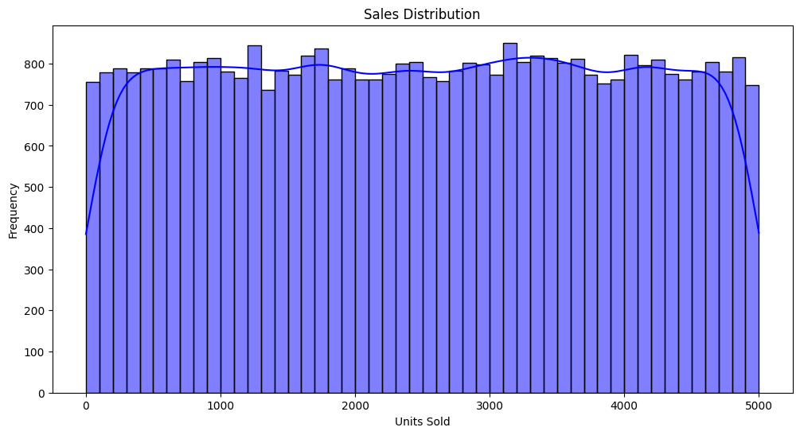
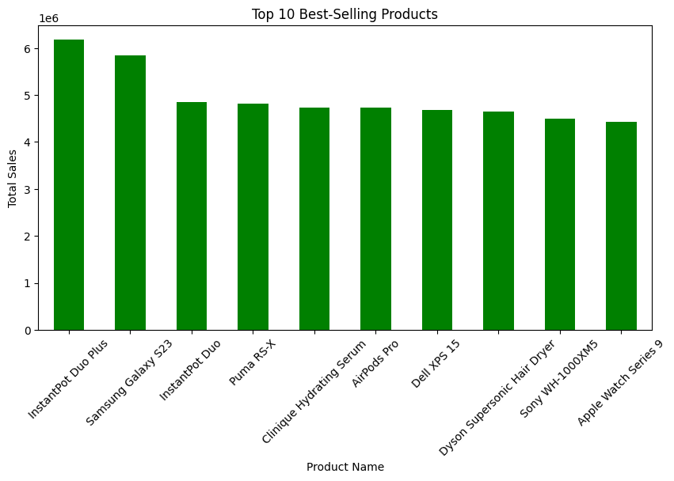
Demand Analysis Logic
High Demand
Criteria: Sales > 1000 units, Satisfaction > 85% Action: Consider price increase due to strong traction.
Moderate Demand
Criteria: Sales between 500–1000 units, Satisfaction 70–85% Action: Maintain current pricing for consistent performers.
Low Demand
Criteria: Sales < 500 units, Satisfaction < 70% Action: Apply discounts or promotions to boost interest.

Slide 7
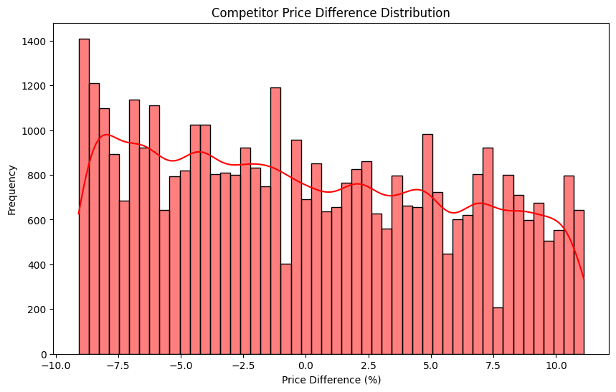
Competitor Analysis
Competitor Price Comparison
Your Price vs Competitor – Direct comparison of product prices.
Overprice Alerts – Highlights if your product is above market average.
Underprice Indicators – Shows potential missed profit opportunities
Performance Context
Criteria: Price, Sales Numbers, Customer Satisfaction, Profit Margin Purpose: Understand competitive standing and product effectiveness. Data-Driven Strategy Suggestions Utilizes data trends to provide actionable pricing suggestions.

Slide 8
MODELS USED
Linear Regression Baseline model assuming a linear relationship between features and target.
Random Forest Regressor Ensemble of decision trees; handles non-linearity and reduces overfitting.
Support Vector Regressor (SVR) Captures complex relationships using kernel tricks; sensitive to tuning.
Lasso Regression Linear model with L1 regularization; performs feature selection.
Ridge Regression Uses L2 regularization; helps mitigate multicollinearity among features.
XGBoost Regressor High-performing gradient boosting model; handles overfitting efficiently.
LightGBM Regressor Fast, scalable boosting model; excels with large, high-dimensional data.

Slide 9
XGBOOST
In the OptiPrice Prognosticator project, XGBoost Regressor emerged as the top-performing model. It consistently delivered the highest R² score and the lowest prediction error among all models tested. Its gradient boosting framework made it ideal for handling complex patterns and preventing overfitting, even in high-dimensional datasets
Why XGBoost Was Chosen
High Accuracy – Outperformed other models in predicting prices.
Efficiency – Fast training and prediction times, ideal for real-time usage.
Scalability – Performs well with large datasets and supports parallel processing.
Robustness – Effectively handled feature interactions and nonlinear relationships.

Slide 10

SYSTEM ANALYSIS AND DESIGN OVERVIEW:
Data Preprocessing – Cleaned data, fixed errors & outliers.
Model Training – Tested models; XGBoost performed best.
Feature Engineering – Used encoding, scaling, and selection.
Streamlit UI – Simple app for inputs, predictions, and insights.
Deployment – Integrated XGBoost for real-time pricing & visuals.

Slide 11
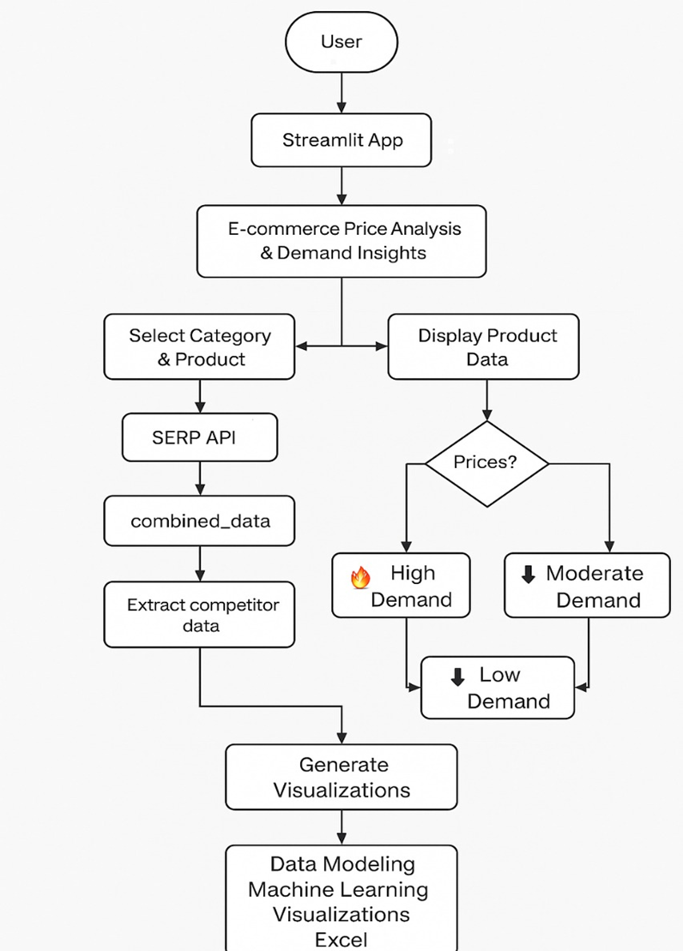
FLOW CHART DIAGRAM

Slide 12
Feature Engineering
Selected Key Features – Focused on impactful variables (e.g., price, margin, satisfaction).
Encoded Categories – Used Label Encoding for model compatibility.
Created Profit Metrics – Added profit percentage for deeper insights.
Cleaned Data – Handled missing values and removed outliers.
Optimized Feature Set – Dropped irrelevant features to boost accuracy and speed.

Slide 13
Real-Life Use Case of Your Project:
Competitor Comparison – Check if your price is higher or lower than others.
Demand Insights – View demand level: high, medium, or low.
Smart Price Suggestions – Get data-driven price recommendations.
Visual Analysis – Charts for quick price and performance comparison.
Multi-Category Support – Works across various product types.

Slide 14
Future Scope: LLM and API Integration
LLM Integration – Provide natural language recommendations and strategy tips.
SERP API Support – Fetch real-time competitor pricing from platforms like Amazon & Flipkart.
Smarter Insights – Combine market data + AI to suggest context-aware pricing moves.
Dynamic Strategy – Auto-respond to market changes (e.g., price drops, sales dips) with tailored suggestions.

Slide 15
CONCLUSION:
The project effectively uses XGBoost to deliver accurate and reliable price predictions for e-commerce products.
It combines machine learning, real-time web data via SERP API, and a user-friendly Streamlit interface to create an intelligent pricing tool.
Business users can make quick and informed pricing decisions based on demand levels, profit margins, and competitor analysis.
The system is modular and scalable, allowing easy future expansion across product categories and platforms.
Overall, it demonstrates the practical use of AI and LLM in solving real-world problems for modern online businesses.

Slide 16


